Slide 1
Object/Image Recognition
Exploring
Convolutional Neural Network(s) (CNN)
Abstract
This is not an instructional presentation

Slide 2
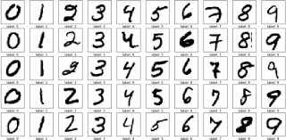
Abstract
Ref 1) The MNIST Database: http://yann.lecun.com/exdb/mnist/
This project will accomplish Image recognition on the MNIST dataset of handwritten digits, available from ref(1). The dataset is separated into a training set of 60,000 examples, and a test set of 10,000 examples. It is a subset of a larger set available from NIST. The digits have been size-normalized and centered in a fixed-size image. See fig(1)
fig(1)

Slide 3



Toolsets
Python was chosen in an effort to further familiarize myself with this programming language.
Anaconda was chosen for its ease of use and its implementation of jupyter notebook for Python coding.
TensorFlow/Keras was chosen because of its growing popularity in doing this kind of work. This toolset was not previously known to me and as a personal goal, I wanted to learn it.

Slide 4
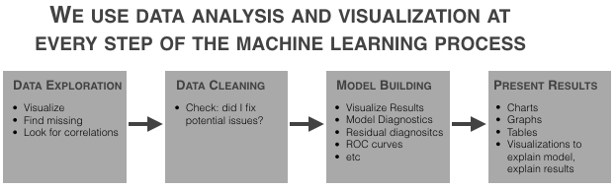
Process
Typically in any data analysis the first steps are to analyze the dataset and prepare it for analysis. In this experiment the dataset has "been size-normalized and centered in a fixed-size image". It is anticipated that the dataset will not have missing records or parts.
Exploratory Data Analysis will consist of verifying dataset integrity and format. Once analyzed, the dataset will be formatted for modeling. Import Data; the raw data files are stored zipped and in a proprietary, binary format. In order to use MNIST data, you must convert the binary data into text data. Typical Exploration and Cleaning Process, see fig(2)
fig(2)

Slide 5
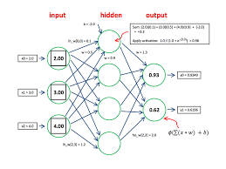
Process
Simple Neural Network will be used/created to predict the Images; this NN is used as a template and comparison to the Convolutional Neural Network; the NN will be a [my own] "bench mark" from which to compare from (i.e. same data, same process, different models)
Diagram
The diagram shows a typical feedforward NN

Slide 6
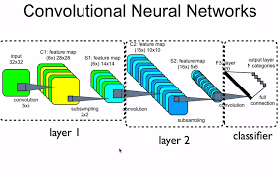
Process
Convolutional Neural Network will be created to predict the MNIST Dataset. Specifically, a CNN model will be created and trained, then prediction accuracy compared to the simple NN.
Diagram The diagram shows a typical Convolutional Neural Network

